Slide 1

FPGA Implementation Of Viterbi Algorithm in grand alliance ATSC system.
Marathwada Institute of Technology.
Department of Electronics & Communication Engineering
Guided by:
Prof: D. L Gadhe.
H.O.D:
Prof: Dr Sayyed Ajij D
Project by:
Shalaka S. Deshpande.
Class: M.E.(Embedded Systems)

Slide 2
CONTENTS
Introduction.
ATSC system block diagram.
Motivation and objective.
Literature Survey.
ATSC DTV and Analog TV system.
System Modelling.
Encoder and Viterbi Decoder block diagram.
Project and Viterbi Decoder Flow chart.
Viterbi Algorithm.
Result and conclusion.

Slide 3



INTRODUCTION
Picture Multiple picture
format & frame rate
Compression
Data header Motion vectors Chroma and luma DCT
Variable length codes. Coefficients.
Transport Flexible delivery of data and future extensibility.
MPEG-2 packets
Transmission Terrestrial 8-VSB
6MHZ
Figure:- Layered Architecture of the ATSC DTV system
Video packet Audio packet Video packet Aux data
19.4 Mbps

Slide 4
DTV system block diagram
Ancillary data
Control data
Video source coding and compress
Service Multiplex and transport.
RF/Transmission
Service multiplex and transport
Channel coding
Transport
Audio source coding and compression
ModulationM
Television receiver

Slide 5
INTRODUCTION
ATSC digital television system.
ATSC digital television standard describes a system designed to transmit – high quality video and audio within a single 6-MHZ terristrial television broadcast channel.
ATSC performance.
The move to digital broadcasting systems has enabled significant step up in performance, quality.DTV can deliver programs free of transmission impairments, throughout the the service area still occupying 6MHZ transmission channel.
Important element of ATSC is flexibility to expand functions.

Slide 6
INTRODUCTION
Motivation and Objective:
Viterbi Algorithm is maximum likelihood algorithm, hence it results in minimum probability of error. It is straight algorithm to implement in hardware.
Purpose behind VA implementation is to achieve low power dissipation, modified trace back a, and high speed.
M. Kivioja , J. Isoaho and L.Vanska (1999) presented implementation of VA on FPGA .Speed , performance, easy routablity, and minimization of inter chip connections were main design criteria.
Sequential and thresholding Algorithm:
Sequential algorithm requires large memory, which depends on communication channel error density. Thresholding is only suited for channels with mid to good SNR ratios.

Slide 7
Architecture of ATSC 3.0 system:-
TS
IP
Sign
LTE
Control
Fig4:- Transmitter(broadcast tower ) and receiver of ATSC 3.0 system.
INTERFACE
Transmitter H
Receiver H
INTERFACE
Transmitter V
Receiver V
LTE
LTE

Slide 8
Architecture description of ATSC3.0 system:-
ATSC 3.0 has developed a physical layer that is compatible with existing ATSC a/53 system and at a same time has abilities that significantly exceed performance of exsisting system.
ATSC3.0 applies to the architecture and development of a new single carrier modulation. Implementing this proposal enables backward compatibility of ATSC3.0 with a/53.
An ATSC3.0 transmitter includes two identical channels ,which may be used for MIMO transmission ,or for H/V polarized transmission. An ATSC3.0 receiver includes corrospondingly two identical channels for receiving of MIMO or H/V polarized signal.

Slide 9
ATSC 3.0 system is hybrid that includes broadcast downstream from broadcasting provider ,and downstream from local LTE operator .Control and management signals are transmitted through upstream of local LTE station.
A customer set top box comprises a special LTE device , which may connect only to broadcast LTE channels and to one of the LTE channels ,dedicated for upstream communication with the broadcast provider.
The architecture allows reliable communication , with a mobile users. when communication fails the user device is connected via the nearest LTE station to a broadcast transmitter and request retransmission of corrupted information . One dedicated LTE channel is used to retransmit , damaged information for all mobile users, in the local area.
ATSC 3.0 system is backward compatible with existing ATSC a/53 standards. There is a significant delay in obtaining correct information .For this reason , the mobile device must be equipped with additional memory. Functional are related with ATSC 3.0 system are charecterstics of physical layer.

Slide 10
LITERATURE SURVEY
Sr no | Author | Topic | Concept
1. | Herbert Dawid (DSP solution group,Germany),Olaf j. Joeressen(Nokia mobile phones) | High performance Viterbi Algorithm and Architecture. | ACS unit modification and metric normalization.
2. | Mark S.Richer(IEEE Member), Glenn Reitmeier(IEEE Member),Robert Rast(IEEE Member)2006. | ATSC Digital Television System. | Various quality services provided by ATSC and its flexibility.
3. | K.S.Arunlal and Dr S.A .Hariprasad.2012. | An Efficient Viterbi decoder(Modified fangled Viterbi decoder) | Variants of VA with reduced complexity but no error detection capability.

Slide 11
LITERATURE SURVEY
Sr no | Topic | Author | Concept
1. | Design Approach of High Speed Parallel Processed Viterbi Decoder with Pipelining Technique. International Journal of Innovative Research in Computer and Communication Engineering. Vol. 3, Issue 10, october 2015. | M.TechScholar,Dept.ofElectronicsEngineering,SDCOE,Selukate,Wardha,India | Viterbi Algorithm implementation on parallel Viterbi Decoder
2. | High performance Viterbi Algorithm and Architecture | HerbertDawid(DSPsolutiongroup,Germany),Olafj.Joeressen(Nokiamobilephones) | ACS unit modification and metric normalization.
3. | ATSC Digital Television System. | Mark S.Richer(IEEE Member),Glenn Reitmeier(IEEE Member),Robert Rast(IEEEMember)2006. | Variousquality servicesprovided by ATSC and its flexibility.
4. | An Efficient Viterbi decoder(Modified fangled Viterbi decoder) | K.S.Arunlal and Dr S.A .Hariprasad.2012. | Variants of VA with reduced complexity but no error detection capability

Slide 12
ATSC digital television and Analog television system
ATSC Digital Television System | Analog Television System
1.Digital TV system has enabled significant step up in performance quality and wider range of services. | 1.Analog TV systems have quality limitations as they are rigidly defined and offer few choices.
2.ATSC DTV system for the first time enabled seperation of camera ,transmission and display properties to achieve resolution twice conventional TV. | 2.In ATV camera ,transmission and display parameters are tightly coupled ,as a part of end to end system. Which limits ability to modify picture resolution.
3.Capability of ATSC system to evolve cause of flexibility, may be its greatest asset and support for HDTV transmission. | 3.Analog TV served public well but has reached its capability to improve , it does not support HDTV transmission.
4.Flat panel display and projection systems with HDTV resolution with HDTV resolution have eliminated physical constraint. | 4.Uses CRT technology, therefore heavy enclosure , circuitary is bulky and complex.

Slide 13
Comparison of ATSC3.0 and HDTV system
ATSC 3.0 | HDTV
Screen can be viewed as a scan lines along with HDTV supports other formats . | Screen supports only HDTV formats conversion of formats not possible.
SCMT and QAM along with 8 ,16,64 VSB modulation schemes (high throughput) | Only 8 and 16 VSB modulation schemes are utilized thus limiting the throughput and bandwidth channel.
Convolution encoder with Reed Solomon encoder is used. | Convolution encoder with Reed Solomon encoder is used.
ATSC 3.0 uses Viterbi Algorithm for error correction. | HDTV uses Viterbi Algorithm for error correction.
It contains mixed data frames each one of them modulated differently. | It contains mixed data frames each one of them modulated similarly.
Multiple input and multiple output transmission is possible presence of 2 channels(uplink & downlink). | One transmitter for multiple receivers. Multiple inputs are broadcasted.

Slide 14
Comparison of Viterbi & Sequential Algorithm
Viterbi Decoder Algorithm. | Sequential Algorithm
Good synchronization as symbol arrival rate is equal to symbol decode rate. | Complexity may cause symbol arrival rate to exceed decode rate &buffer overflow.
Trial and error strategy is avoided. | Trial and error strategy is implemented.
Recovery of signals is possible during reduced SNR due to interleaving . | Reduced SNR causes increase in poor hypothesis and hence error rate.
Number of iteration are reduced with maximum likelihood decoding including Decision unit. | Number of iterations may increase if value of sequential path is greater than prescribed threshold value.
Comparison is avoided with next selected branch to get the decoded bits. | Comparison of selected branch is done with next set of received symbol.
Soft decision can be used ,as it can be implemented in parallel & clock gating scheme. | Soft decision cannot be used as it further increases the complexity & higher number of bits are traced back.

Slide 15
Comparison between Parallel Viterbi & Conventional VD
Parallel Viterbi Decoder. | Conventional Viterbi Decoder.
1)Number of stages are divided into clusters. Thus reduced number of states. | 1)Number of stages are attached thus increasing the complexity & hence increase in number of states.
2)Power consumption is reduced. | 2)Power consumption is high compared to parallel VD.
3)Throughput is increased by implementing pipelining technique. | 3)Throughput is normal as we require buffering of information till previous data is transferred to ISOD unit.
4)Selective update scheme i.e vertical arrangement of registers to reduce switching activities. | 4)Shift update scheme i.e horizontal arrangement of registers.

Slide 16
SYSTEM MODELLING
Parameters:
In most real time application like audio and video applications the convolution codes are used for error correction. Convolution coding with viterbi decoding is FEC technique that is suited to a channel in which transmitted signal is corrupted mainly by white gaussian noise.
Convolution code parameters are code rate ,generating polynomial, number of input bits, number of output bits, and constraint length.
Code rate is number of transmitted bits per input bits eg . A rate ½ encodes 1 bit and produces two bits for transmission. Constraint length is length of one generator polynomial in bits .The higher it is more robust is the code.

Slide 17
Block Diagram of Viterbi Decoder(Traceback)
Path metric unit.
Add Compare Select Unit.
Survival memory unit.
Branch metric unit
Notes:
Input is given to the branch metric unit and output is taken from survival memory unit. Figure shows block diagram of Viterbi decoder.

Slide 18
Viterbi Decoder
Parallel Viterbi Decoder is created by dividing conventional Viterbi Decoder into clusters each cluster is having equal number of states(12). We can also use pipelining technique in this decoder such that instruction is fetched ,decoded and executed , in lesser number of clock cycles.
It increases the throughput rate at the cost of increase in the area, power consumption depends on the clock frequency. Output of each parallel stage i.e survivor path is saved in registers.
Viterbi Decoder important units are:
Branch metric unit.
Path metric unit.
Survivor memory unit.

Slide 19
VITERBI DECODER(Register Exchange)
Figure2:- Block diagram of Viterbi Decoder.
Viterbi decoder consist of following blocks.
Branch metric computer.
Path metric updating and storage.
Information sequence update register.
Information sequence output decision.
Branch metric
Computer.
Path Metric Updating and Storage.
Information sequence updating and storage.
Information sequence output decisions.

Slide 20
VITERBI DECODER
From BMC
To ISUS
Figure3:- Add compare select unit of VD.
Comparison between two path metrics is done and one with least value of path metric is selected.
Mux
2 to 1
+
PMA
Compare
+

Slide 21
VITERBI DECODER ISUS UNIT
PMUS
Register
Updating
Controller.
FF#0 to FF #15
PMUS
FF#0 to FF#15
PMUS
FF#0 to FF#15
PMUS
FF#0 to FF#15

Slide 22
VITERBI DECODER ISOD UNIT
The final part of Viterbi decoder is ISOD unit, ISOD keeps refreshing and recording all useful information obtained through decoding procedure. If survived paths merge ,path with smaller path metric is chosen as a survived path.
According to sequence of maximum likelihood path it declares state transitions and position of branches connecting state transitions are our message sequence. ISOD traceback the survived path and gives decoded bit stream out.
Information bit out.
Figure:-ISOD unit of Viterbi Decoder.
. ……. FF#14 FF#15
………… FF#14 FF#15
……….. FF#14 FF#15
……….. FF#14 FF#15

Slide 23
VITERBI DECODER.
Branch metric computer computes metric associated with each branch. The responsibility of this unit, is to compute hamming code and at each processing step it finds hamming codes for the symbols.
It computes branch, sums up the branch to obtain branch metric. The result of BMC is passed as the input to path metric calculator.
Path metric unit computes partial path metric at each node of trellis. ACS is main unit of survivor path decoder. The function of this unit is to find the addition of hamming code.

Slide 24
VITERBI DECODER
Surviving path at each node is identified and ISUS information sequence updating and storage unit is notified accordingly. Single circuit called add compare select unit may be assigned to each trellis state.
ISOD unit is responsible for keeping track of the information sequence bits associated with surviving paths designated by the path metric calculation. A shift register is associated with every trellis node to keep track of transitions and position of link related with maximum likelihood path. Traceback method of ISOD is given more preferance as register exchange method consumes more area.

Slide 25
Trellis Clusters Of Parallel VD
00 00
11 11
10 10
01 01
11 00 11 00
01 01
10
10
Notes:
Fig1 shows first division of parallel VD. it consist of 4 states and total 12 states present in VD. Considering the column wise naming of states first state is 00 ,second 01 and third 10 and fourth 11. Switch matrix connections are indicated by colors for detecting source decoded bitstream. Green indicates decoded bitstream 0, red indicates decoded bitstream 1.Lavender indicates selection of survivor path when my received sequence is 1101. Here decoded output is 11

Slide 26
Cluster 2:-
00 00
11 11
11 11
00 00
10 10
01 01
01 01
10 10
Notes:
Fig2:- shows second cluster of parallel Viterbi Decoder, lavender line shows selection of survivor path if input sequence is 1100 ,as first cluster is ending at 4 computation starts from state four to establish connctivity. Here both branch metric values 01 and 10 are same but it has selected 01 as it is connecting with 00 i.e second sequence, because no branch is matching the input sequence 11 so decision is made considering second sequence 00.

Slide 27
Cluster 3:-
00 00
11 11
11 11
10 10
00 00
01 01
01 01
10 10
Notes:
Cluster 2 is ending at second state so three has to start from second for connectivity, as input sequence is 0110, it will calculate hamming distance select branches which are matching the received sequence and connected with each other.

Slide 28
Cluster 4:-
00 00
11 11
11 11
10 10
00 00
01 01
01 01
10 10
Notes:
Cluster 3 ends at 4 hence cluster4 starts at 4th point ,as input sequence 0011 again there is a conflicting situation 01 and 10 having same branch metric value so selection is done on the basis of next stream of sequence i.e11 as 01 is connecting 11 we have to select connecting switch.

Slide 29
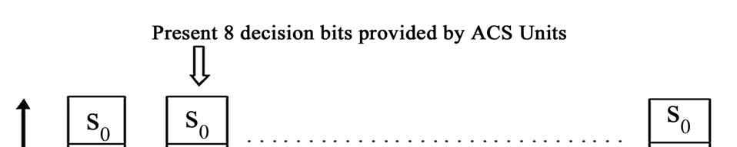
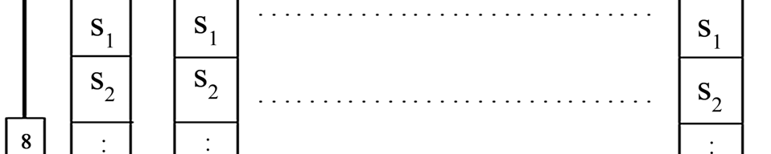
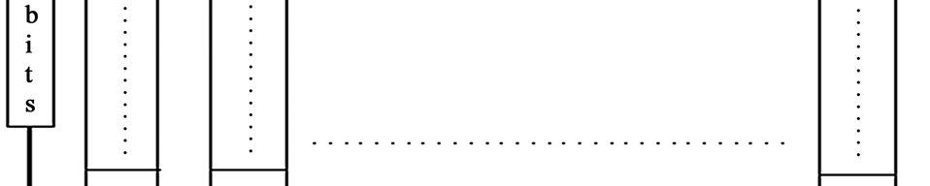
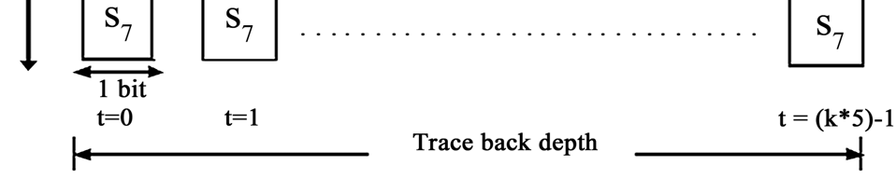
Parallel Viterbi Decoder selective update scheme.

Slide 30
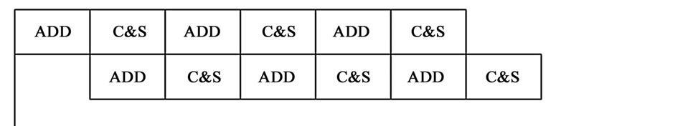
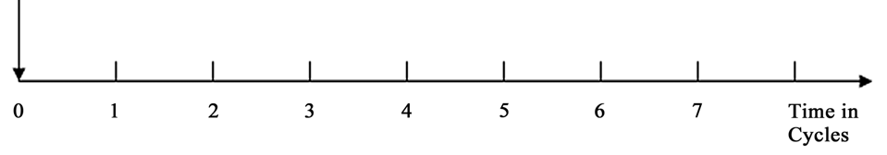
Parallel pipelined execution of ACS unit.

Slide 31
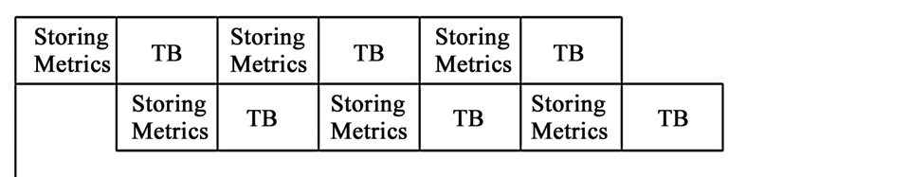
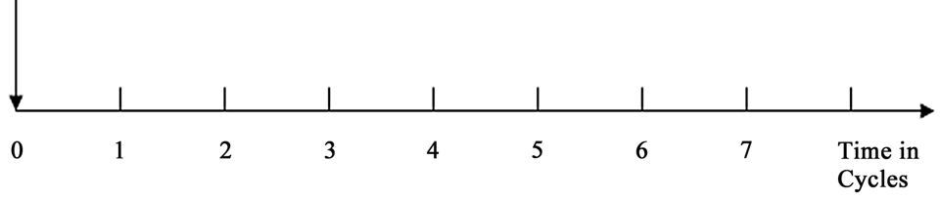
Parallel Pipelined Execution of trace back unit.

Slide 32
PROJECT FLOWCHART
Input bitstream
Redundancy addition (Convolution encoding)
Interleaving
8-VSB Modulation and transmission
Demodulation
Viterbi decoding
Deinterleaving

Slide 33
Viterbi Decoding Flowchart
Start
No
Yes No
Yes
Initialize
Branch metric calculation
Load Branch metrics
ACS
Path info Buffer
States end
Trellis end
Decoded bits
End

Slide 34
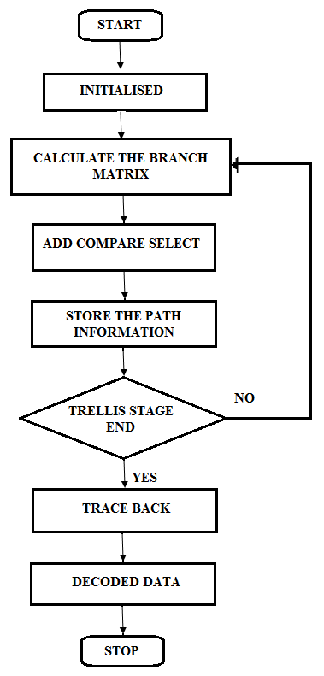
Parallel Viterbi Decoder Flowchart

Slide 35
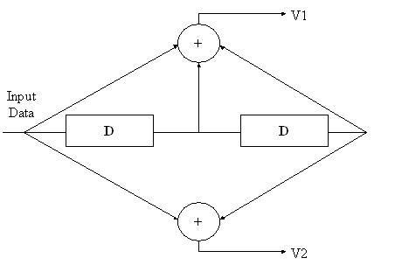
CONVOLUTION ENCODER
Figure:-Block diagram of ½ convolution encoder
Convolution encoder is similar to finite state machine ,k bits are fed to input of encoder and n outputs are calculated from generator polynomials by modulo 2 addition.

Slide 36
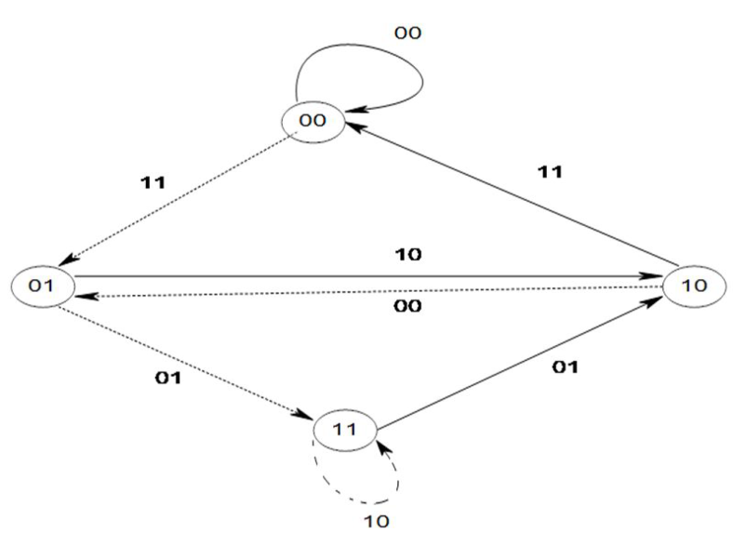
CONVOLUTION ENCODER
Generator polynomial specifies connections of encoder to modulo 2 adder. The 1 in generator polynomial indicates connections and 0 indicates no connection between stage and modulo 2 adder.
Convolution encoder can be described in terms of state diagram and trellis diagram .State diagram shows transition between states .Trellis diagram is description of state diagram.
00 0/00 00
1/11
01 0/11 01
1/00
0/10
1/01
10 10
0/01
1/10
11 11
Figure:-State and trellis diagram of convolution encoder.
Figure:-Trellis diagram and state diagram of Convolution encoder.

Slide 37
TRELLIS ENCODER
X1 Y2 Z2
X2 Y1 Z1
Z0
MAP
Z2Z1Z0 R
0 0 0 -7
0 0 1 -5
0 1 0 -3
0 1 1 -1
1 0 0 +1
0 1 +3
1 1 0 +5
1 1 1 +7
D
D
D

Slide 38
INPUT OUTPUT TABLE TRELLIS ENCODER
INPUTS TO TRELLIS ENCODER( CONVOLUTION ENCODER OUTPUT) | 2/3 TRELLIS ENCODER OUTPUTS
00=>11 | 111 +7
11=>01 | 110 +5
01=>11 | 110 +5
11=>00 | 101 +3
00=>01 | 011 -1

Slide 39
TRELLIS STRUCTURE(TRELLIS DECODER)
00 111 110 110 101 011
01
10
11

Slide 40
VITERBI ALGORITHM
Author: Keshab K.Parhi,(VLSI digital signal processing)Viterbi algorithm is based on dynamic programming . It is used to detect sequential error control codes such as convolutional codes.
It is optimum to find most likely noiseless sequence given a noise corrupted finite state sequence. State transition consists of states and there are two possible outgoing edges from each state assuming input of 1 and 0.
On each edge corrosponding input and output is denoted. State transition diagram can be described by time equivalent trellis diagram, which describe state transition from instance n to n + 1.

Slide 41
VITERBI ALGORITHM
0/00 1/01 n 0/00 n +1
S00 S00
1/11
S01 0/01 0/11 S01
1/11 0/10
1/01 0/11 1/00
S10 1/10 S10
1/00
0/10
0/01 S11 S11
1/01
Figure1:-Example of four state machine and its trellis diagram representation
S00
S11
S01
S10

Slide 42
VITERBI ALGORITHM
Sequence of symbol generated trellis is corrupted by noise then VA uses hamming distance to calculate difference between received sequence and encoded sequence.
Survivor path for a given state at time instance n is sequence of symbol closest in distance to the received sequence.
Assume received symbol as v(n)=11, using hamming distance ,branch metrics for all transactions in trellis can be computed as
S00S00= weight (|11 - 00|) = 2
S00S01= weight(|11 – 11|)= 0
S01S10= weight(|11 – 01|)= 1
S01S11= weight(|11 - 10|)= 1

Slide 43
VITERBI ALGORITHM
S10S00 = weight(|11 - 11|)=0
S10S01= weight(|11- 00|)=2
S11S10= weight(|11- 10|) =1
S11S11= weight(|11 – 01|)=1
There are two possible paths entering each state the one with larger metric is discarded and with smaller metric is retained. Viterbi algorithm includes computing branch metrics , updating path metrics and tracing back its survivor path.
Path metric update requires addition, comparison and selection (ACS) speed of viterbi decoder is limited by recursive ACS operations.

Slide 44
STEPS OF VITERBI ALGORITHM
Weight the trellis that is calculate branch metrics.
Recursively compute the shortest path to time n in terms of shortest path to time n +1. In this step decisions are used to recursively update the survivor path of the signal. This is known as add compare select recursion. Recursively finds shortest path using previous decisions.
The shortest path is called survivor path is process is called survivor path decode .Finally survivor path is traced back in time ,which is most likely signal path.

Slide 45
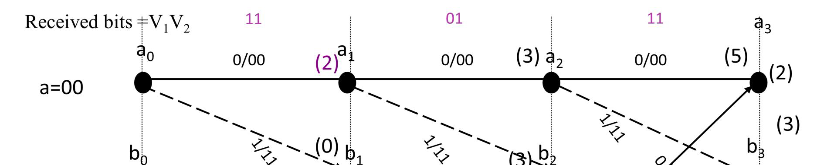
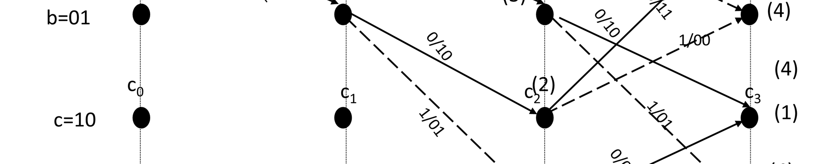
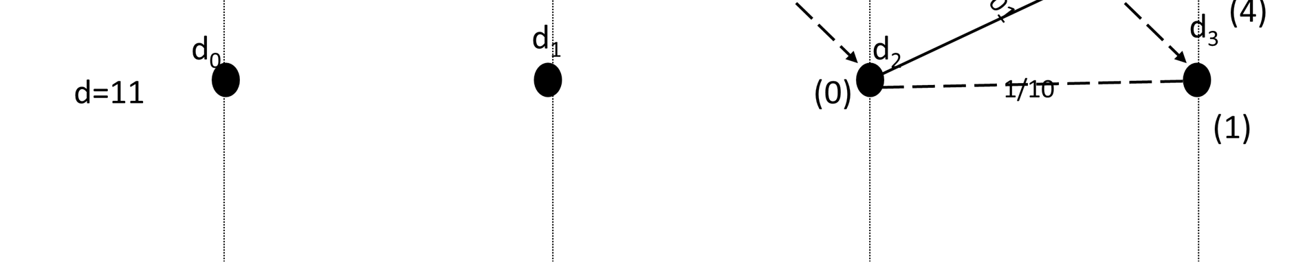
Diagram representing Viterbi Algorithm

Slide 46
VARIOUS TYPES OF VITERBI DECODERS
Parameters | Conventional VD | Fangled VD | Modified Fangled VD | Efficient Fangled VD | Efficient Fangled VD
1)Error correction capability | 2 | 0 | 1 | 1 | 2
2)Processing time | 650 ns | 150 ns | 300 ns | 150 ns | 150 ns
3)Number of additions required | 46 | 14 | 28 | 16-18 | 18-22
4)Number of comparisons required | 20 | 7 | 14 | 8-9 | 9-11
5) Device Utilization (Gate counts) | 5242 | 1019 | 1194 | 1542 | 1758

Slide 47
VARIOUS TYPES OF VITERBI DECODER
Parameters | Conventional VD Trace back | Parallel VD trace back | Modified Fangled VD | Efficient Fangled VD
1)Error correction capability | 2 | 2 | 1 | 2
2)Processing time | 8.128ns | 6.788ns | 300 ns | 150 ns
3)Number of Additions &comparison | 20 | 8 | 28 | 18-22
5) Device Utilization (Gate counts) | 5242 | 2 xor (6-bit) | 1194 | 1758

Slide 48
VD ANALYSIS ON VARIOUS DEVICES
 | ASIC | Micro-controller | FPGA | DSP
1)Area Utilization (Transistors Used) | Best | good | good | good
2)Performance | Best | good | better | good
3)Total Design Time | Good | Very good | best | Very good
4)Flexibility (Non- Recurring Engineering Costs ) | Not much | good | best | good
Table:-Comparison of VA on several technologies.

Slide 49
RESULTS
Module Name: Viterbi Decoder
Target device: XC2S15-5CS144
Device utilization report:
Table:-Device utilization by Viterbi decoder.
Logic utilization | Used | Available | Utilization
1)Number of slices | 104 | 192 | 54%
2)Number of slice Flip flops. | 16 | 384 | 4%
3)Number of 4 input LUT | 185 | 384 | 48%
4)Number of bounded IOBs | 385 | 86 | 447%

Slide 50
RESULTS OF PARALLEL VITERBI DECODER
Module name:-Parallel Viterbi Decoder.
Target Device:-XC2S200-6PQ208.
Device utilization report.
Table2 :-Device utilization of Parallel Viterbi Decoder.
Logic utilization | Used | Available | Utilization
1)Number of slices | 9 out of 2352 | 2352 | 0%
2)Number of slice Flip flops. | 16 out of 384 | 384 | 0%
3)Number of 4 input LUT | 16 out of 4704 | 4704 | 0%
4)Number of bounded IOB’s. | 78 out of 140 | 140 | 55%

Slide 51
Memory usage and Timing Analysis
Minimum input arrival time before clock: 6.130ns.
Maximum time required for output after clock: 8.128ns.
Maximum combinational path delay: 19.539ns.
Memory usage: 56660 kilobytes.
Number of GCLK used : 1 (Available 4)
Utilization of bounded IOB’s is more as data computed from previous logic blocks is required for preceding units to achieve the desired output.
Input bits of VD corrosponds to input of 4 input LUT.

Slide 52
Timing Report of Parallel Viterbi Decoder
Speed Grade: -6
Minimum period: No path found
Minimum input arrival time before clock: 4.182ns
Maximum output required time after clock: 6.788ns
Maximum combinational path delay: No path found
Timing Detail:
--------------
All values displayed in nanoseconds (ns)

Slide 53
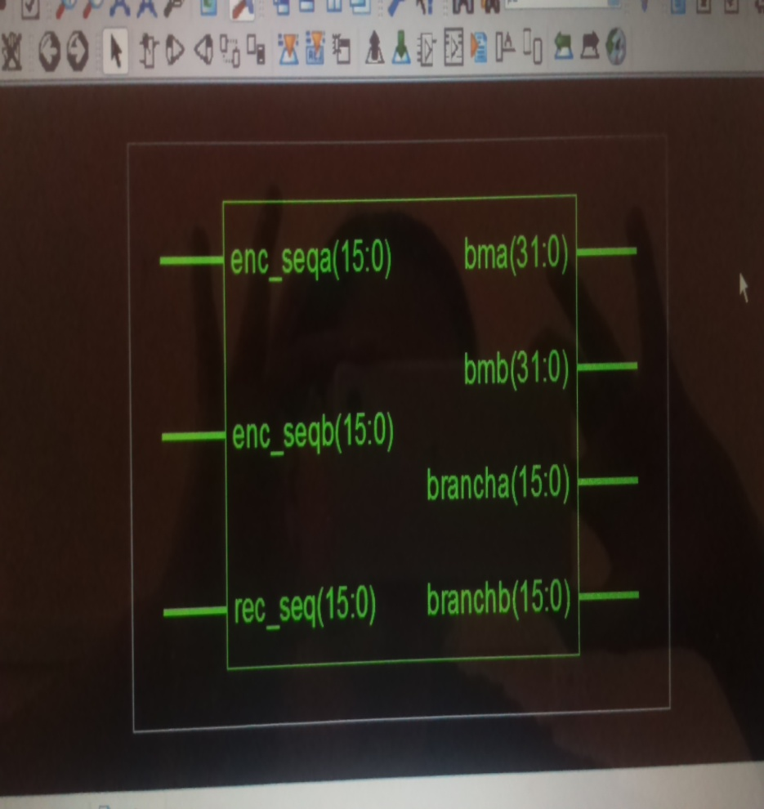
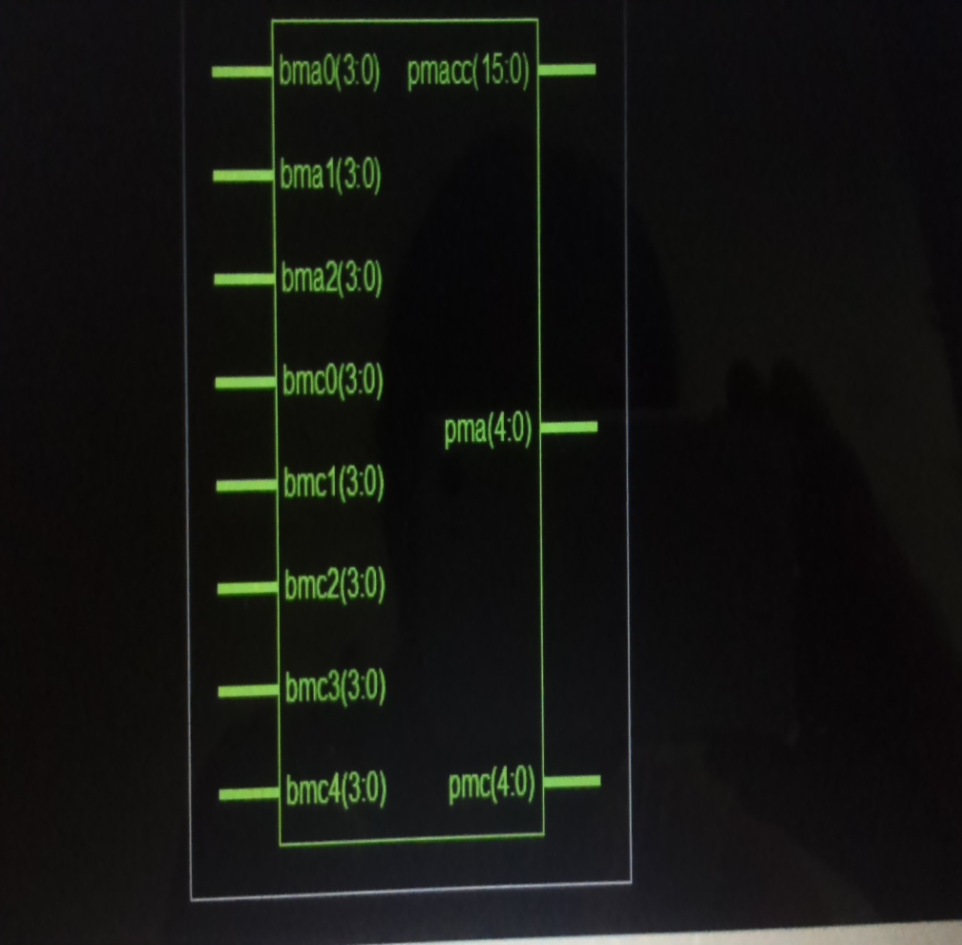
Synthesis results of Branch metric and path metric computation.

Slide 54
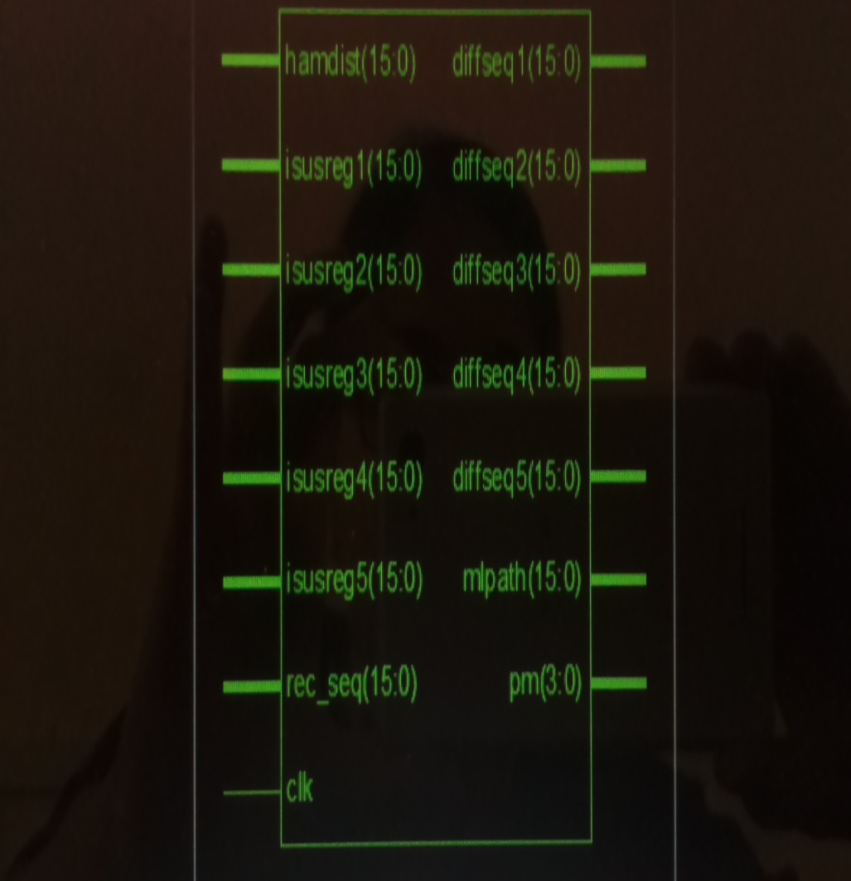
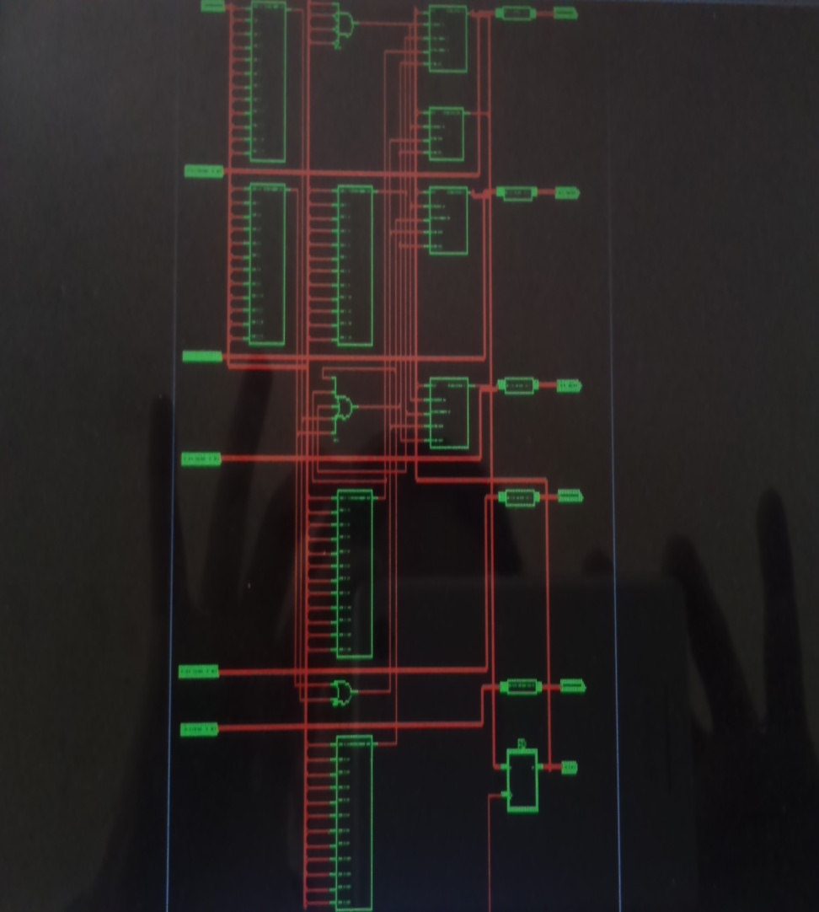
Synthesis results of ISUS and input sequence output decision.

Slide 55
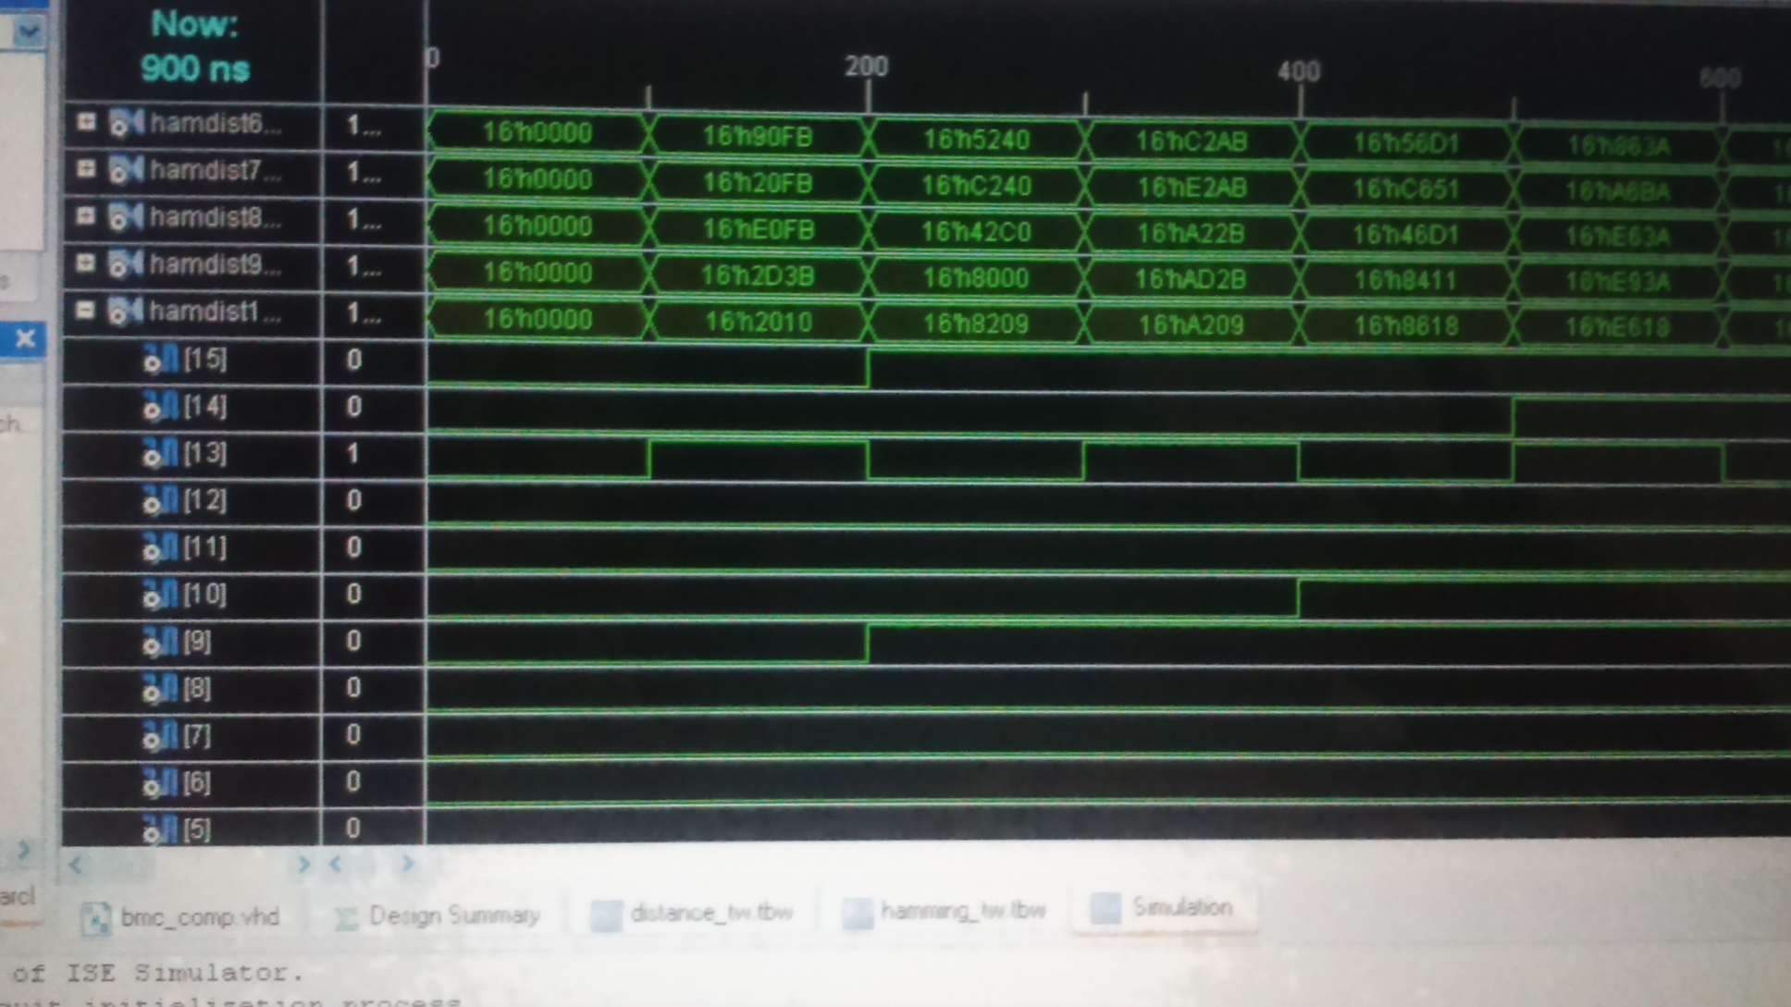
Simulation results for hamming distance calculation in branch metric unit.

Slide 56
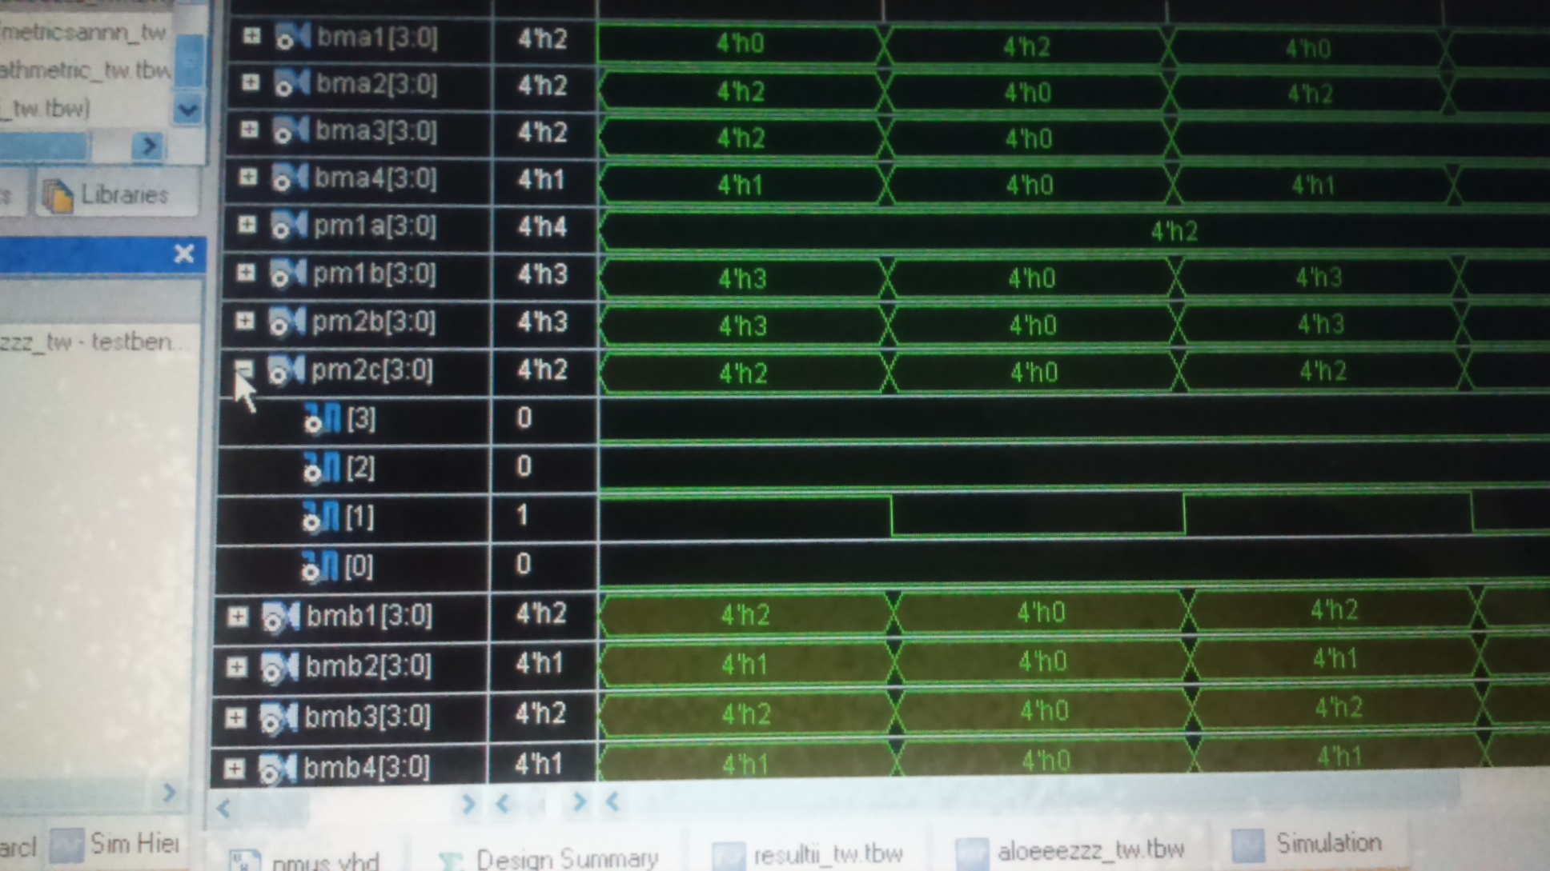
Simulation results for calculation of branch metrics and partial path metrics.

Slide 57
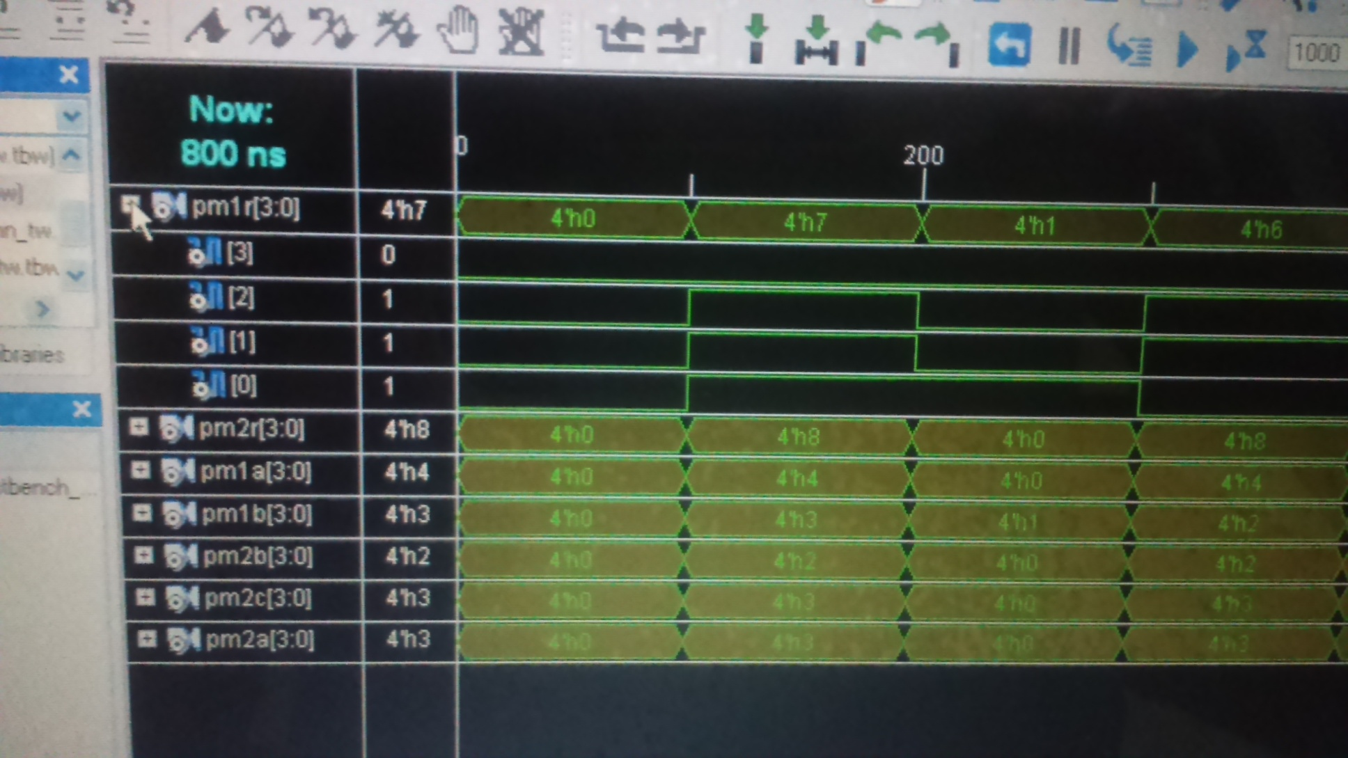
Simulation results for path metric computer

Slide 58
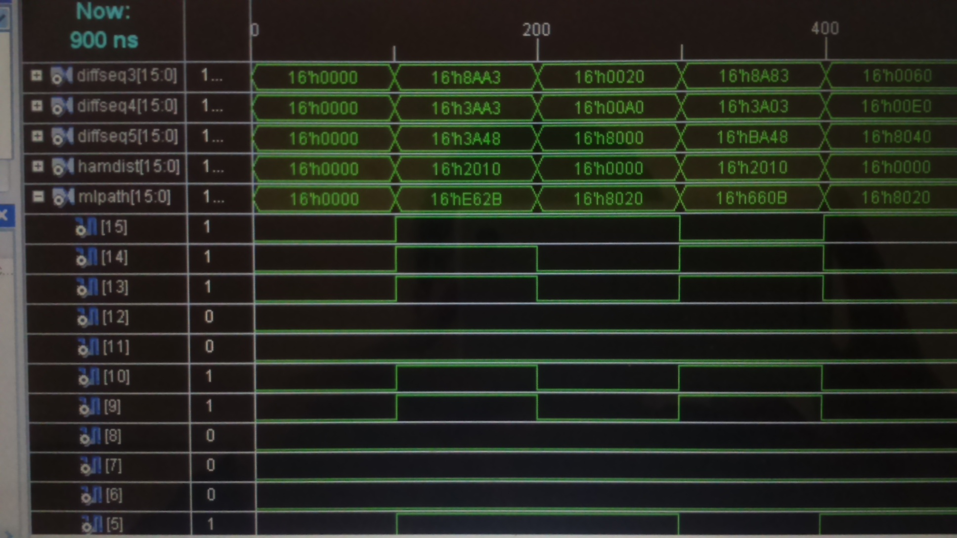
Simulation results for maximum likelihood path selection.

Slide 59
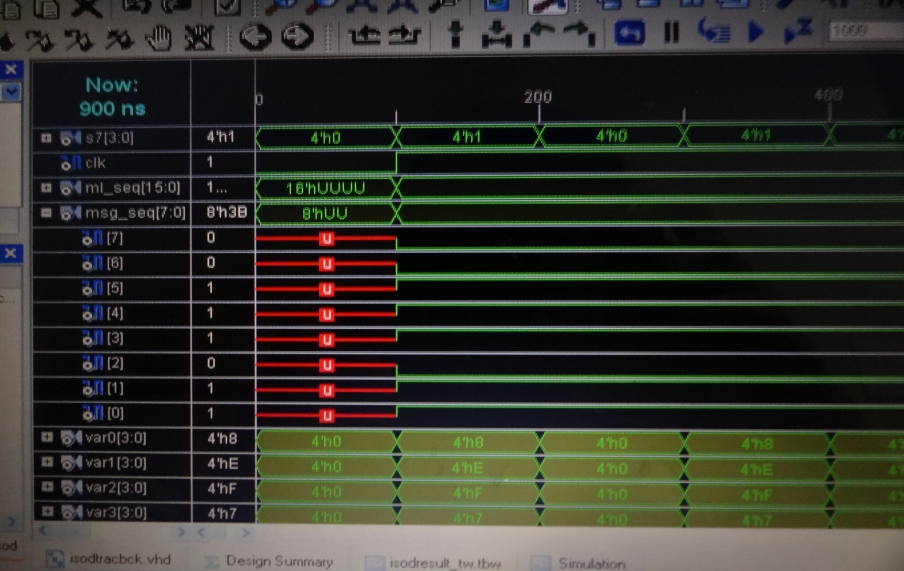
Simulation results for ISOD unit displaying decoded message bit stream.

Slide 60
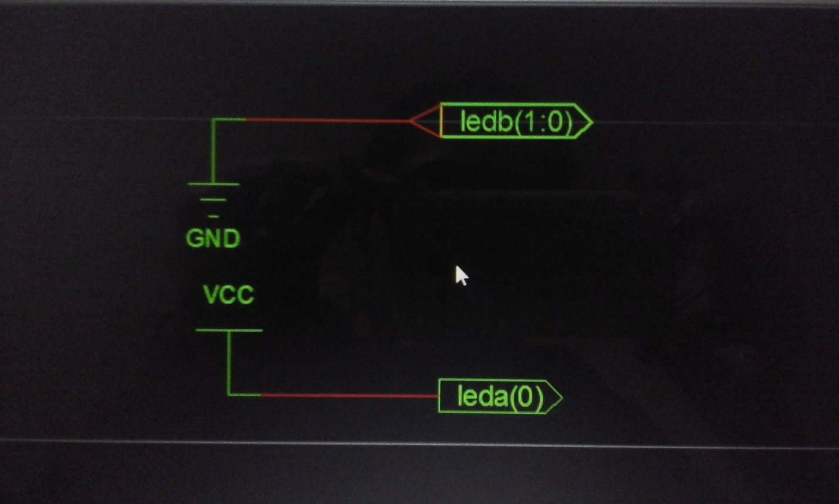
Synthesis results of Parallel Viterbi Decoder
Fig1:-RTL schematic of parallel Viterbi decoder

Slide 61
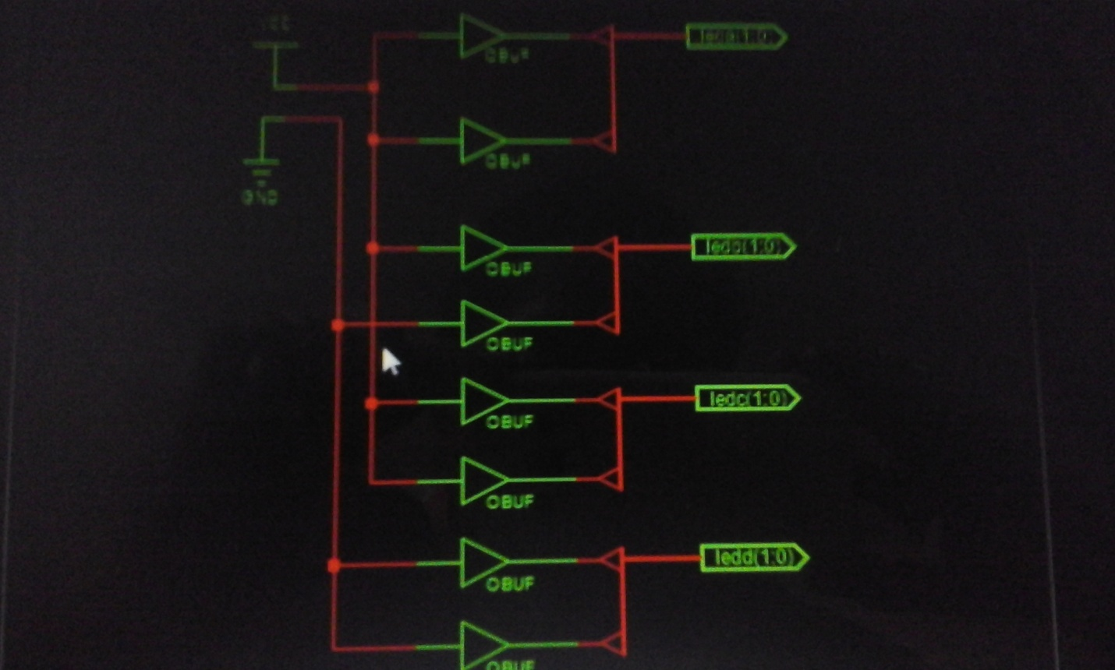
Synthesis results of Parallel Viterbi Decoder
Fig2:- Technology schematic of Parallel viterbi decoder.
Fig2:- Technology schematic of Parallel viterbi decoder.
Fig2:- Technology schematic of Parallel viterbi decoder.
Fig2:- Technology schematic of Parallel viterbi decoder.
Fig2:- Technology schematic of Parallel viterbi decoder.

Slide 62
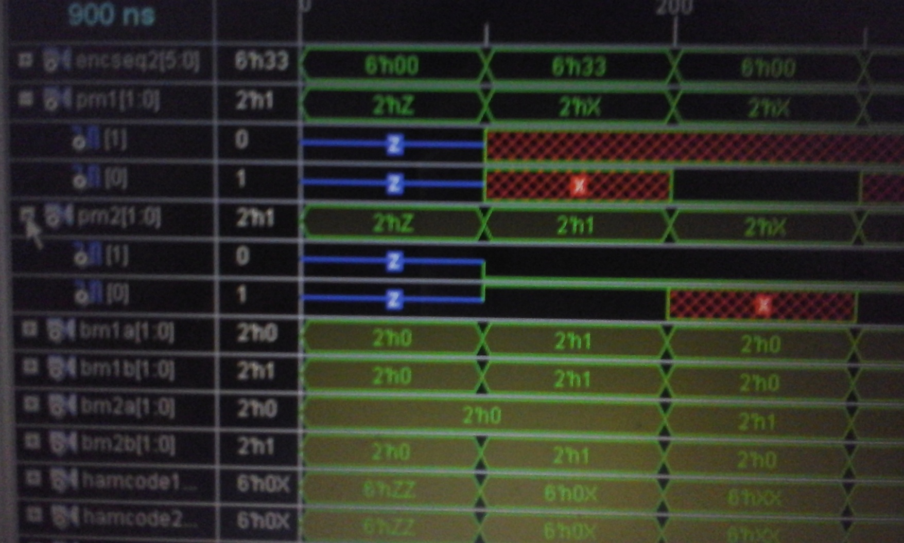
Results displaying Path Metric Computation:-

Slide 63
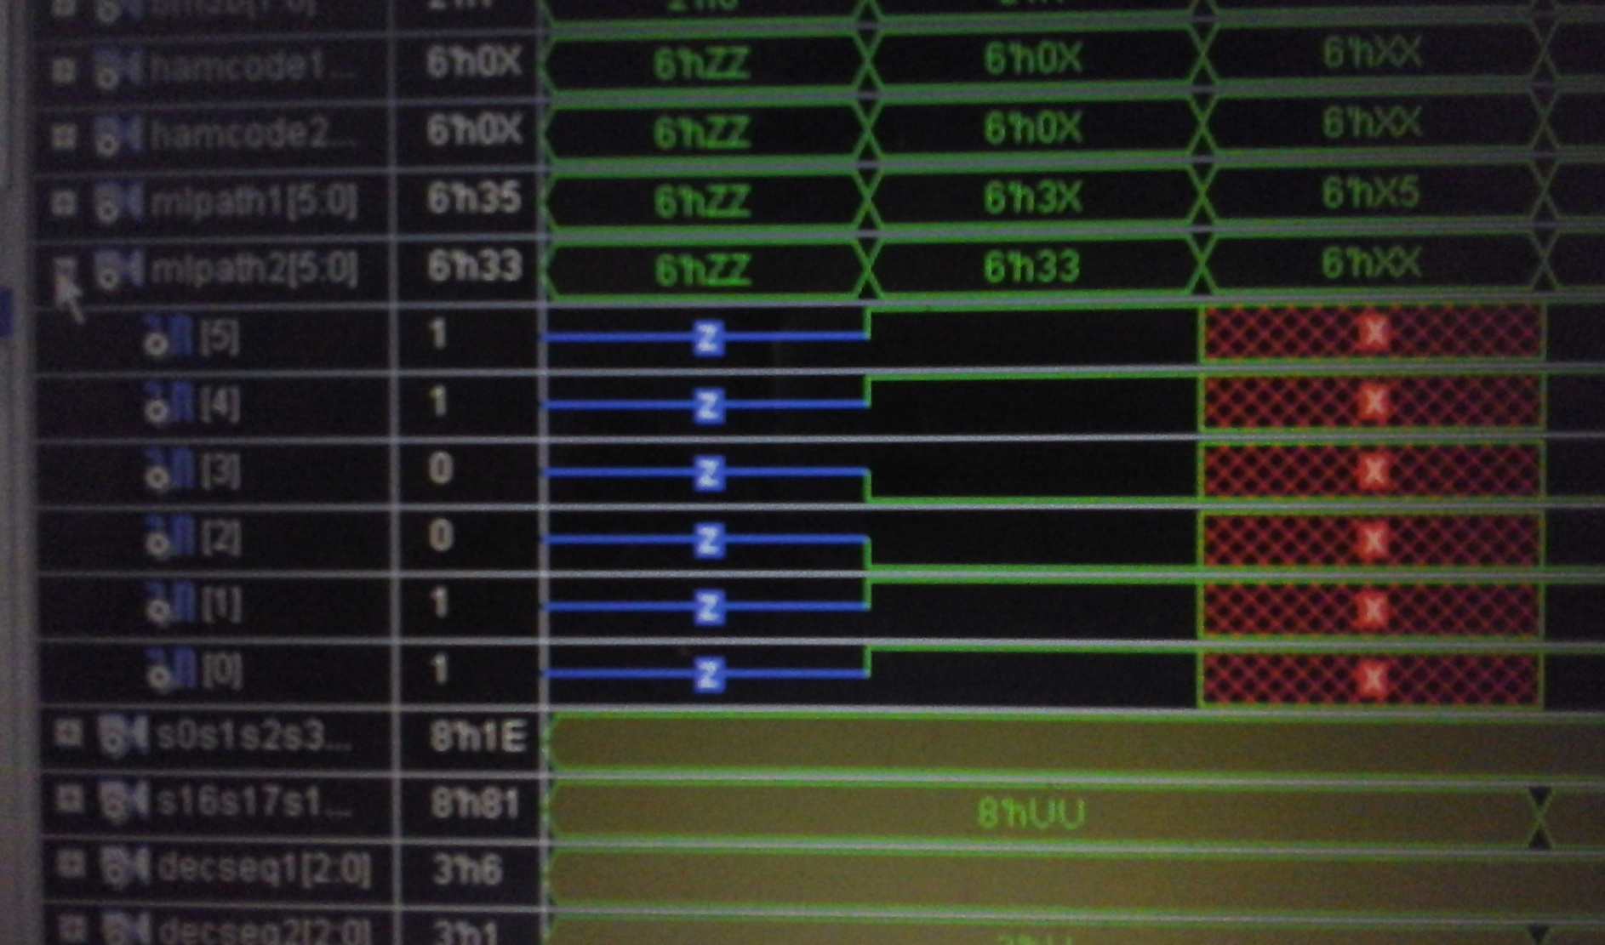
Results For MLP Selection:-

Slide 64
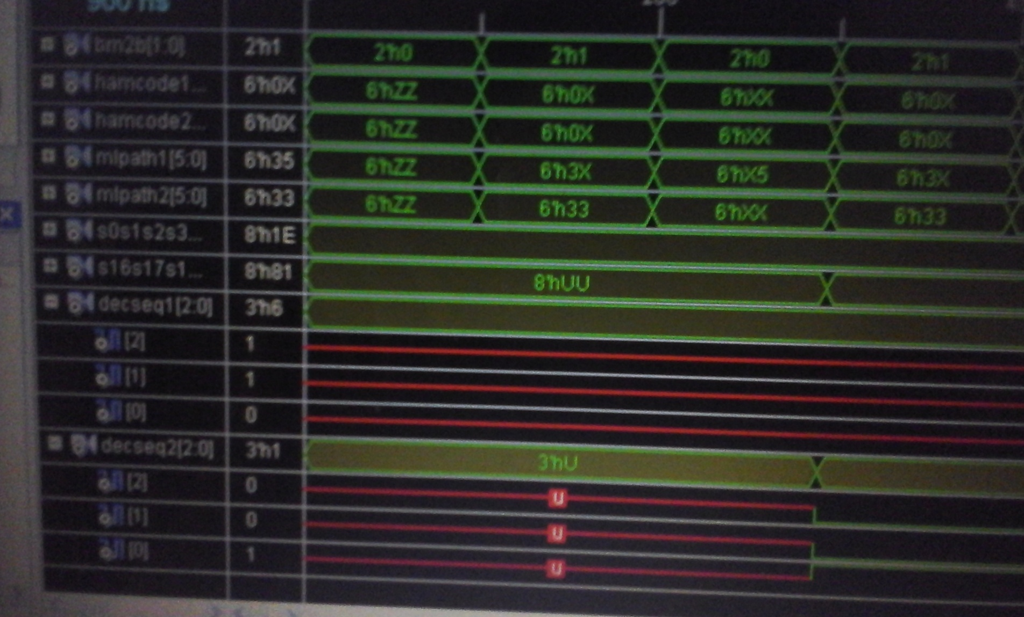
Simulation results(Decoded output sequence):-

Slide 65
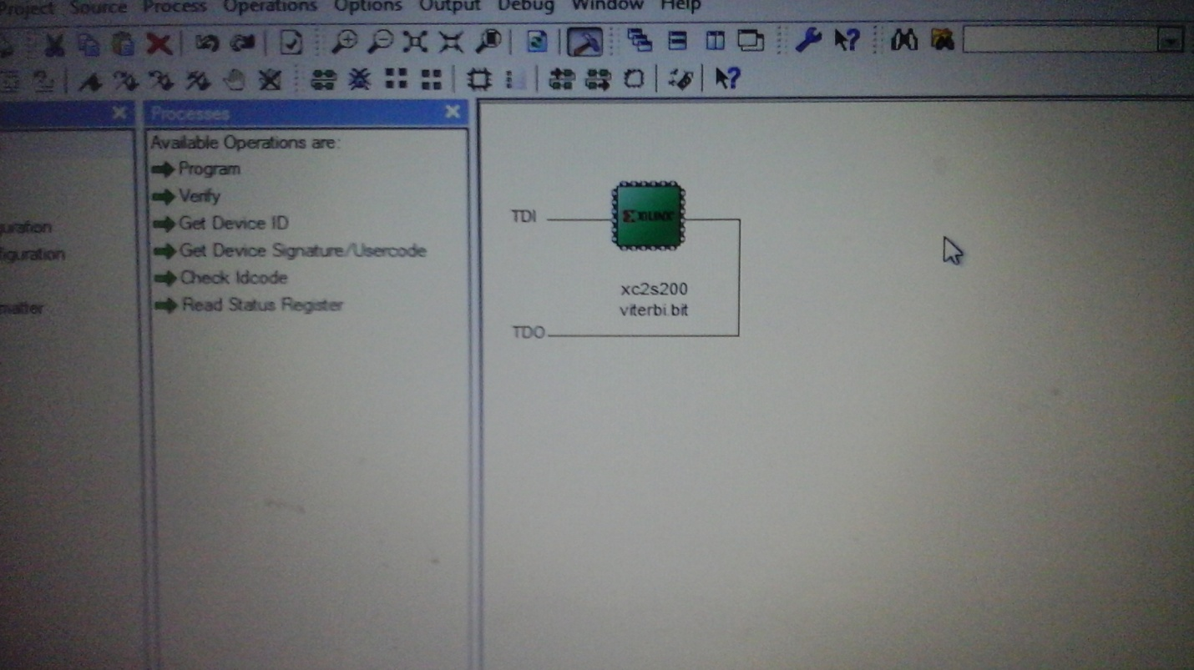
Configuration of target device(impact):-

Slide 66
CONCLUSION
Viterbi Algorithm is efficient choice for decoding convolutional codes. It plays very important role in channel coding theory. In this project we have focused on Implementation of the error control scheme, used in ATSC system. We observed simulation results of Convolution encoder and Viterbi decoder.
In this way ,I have analysed the simulation and synthesis results of parallel Viterbi Decoder and analysed its timing report on Spartan-2 XC2S200-6PQ208 device .Parallel pipelined implementation leads to increased throughput, reduced power consumption( function of clock frequency).

Slide 67
APPLICATIONS
There are various application of VA in communication.VA can be used to decode convolution codes, and it can also be used as an equalizer in different communication environments. It can also be used for decoding TCM codes.
VA is also used in target tracking system, to produce estimates of target states, be it in terms of speed, position, or accelaration.
VA is also used in areas of pattern recognition, where it has been used to detect edges and carry out region segmentation of image .VA is also used in neural networks to recognize continuous speech.

Slide 68
REFERANCES
1) IEEE Transactions on industrial electronics VOL:48 , No.5
Wan-De-Weng (Member IEEE),Wen Pin Yang. CPLD implementation of Viterbi Algorithm in Grand Alliance ATSC Systems.2001IEEE.
2) Principles of Digital Systems Design using VHDL (Authors: Charles H. Roth, Lizy Kurian John.
3) Proceedings of the IEEE, Vol.94,No.1,January 2006. Mark S. Richer, Tom Gurley, Robert Rast(Members IEEE).The ATSC Digital Television Systems.
4) VLSI Digital Signal Processing: Keshab K. Parhi.
5) Information Theory and coding Techniques: J.S Katre.
6) Fundamentals of Convolution Coding :Rolf Johannesson,
Kamil sh. Zigangorov. IEEE Press.
7)Viterbi Decoder :High Performance Algorithms and Architectures,(HerbertDawid(DSP solution group,Germany).
8)An efficient Viterbi Decoder(KS Arunlal and Dr Hariprasad(RV centre of cognitive Technologies, Bangalore)

Slide 69
REFERANCES
9)Information Theory and coding Techniques: J.S Katre.
10) Design Approach of High Speed Parallel Processed Viterbi Decoder with Pipelining Technique. International Journal of Innovative Research in Computer and Communication Engineering. Vol. 3, Issue 10, october 2015.
11)www.techtronix.com/Video_Audio.Fundamentals of 8 VSB.
12) ATSC 3.0 Physical Layer Proposal. Guarneri communications ltd. September 27, 2013. A Terrestrial Broadcast Standard.

Slide 70
THANK YOU.

